Slide 1
Programming assignment - 2
Monica Bernard
COT 5405

Slide 2
Overview of Preferential Node Addition and Deletion in Dynamic Models:
Linear Preferential Attachment Rule for Birth Process: With a probability p, a new node is added along with a new edge incident on it. The other-end (node ‘u’) to which the new edge will join is chosen based on the probability distribution given by:
P_{t + 1} [u] = d_{t} (u) ÷ (2m_{t}), where t is the discrete time step, d_{t}(u) is the degree of node ‘u’ and m_{t} is the total number of edges in the graph G_{t}.
Linear Preferential Deletion Rule for Death Process: With a probability q (where q = p - 1), a node ‘u’ is chosen for deletion along with all the edges incident on it in graph G_{t} based on the probability distribution given by:
P_{t + 1} [u] = [n_{t} – d_{t} (u)] ÷ [n_{t}² - (2m_{t})], where t is the discrete time step, d_{t}(u) is the degree of node ‘u’ and m_{t} is the total number of edges in the graph G_{t} and n_{t} is the total number of nodes in the graph G_{t}.

Slide 3
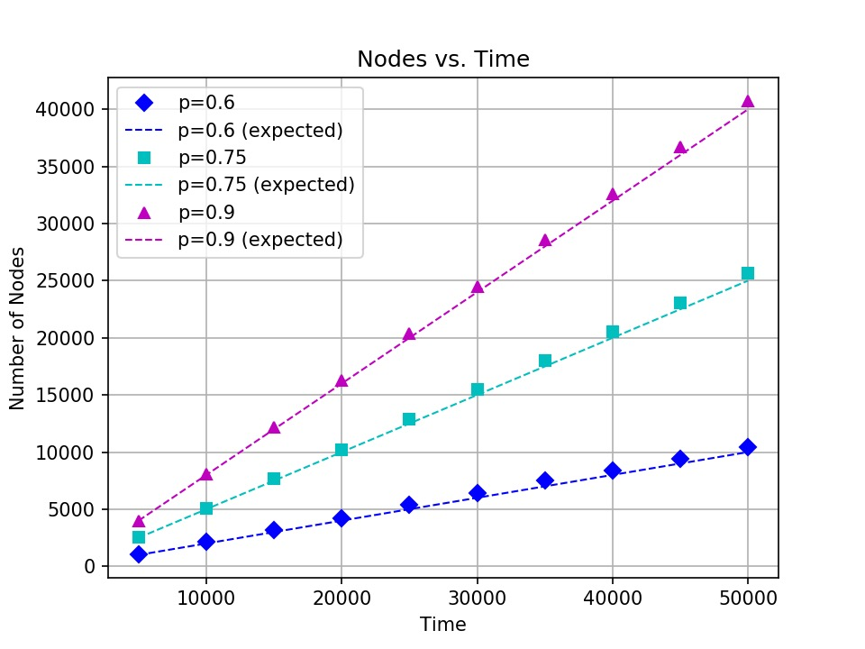
Distribution of Nodes with change in Time
From the graph, it can be noticed that as time ‘t’ increases, the number of nodes (n_{t}) in the graph G_{t} increases linearly.
The analytical formula to find the find the expected number of nodes with change in t is given by: E(n_{t}) = (p – q)t Where p is the probability of adding a node and q is the probability of deleting a node.

Slide 4
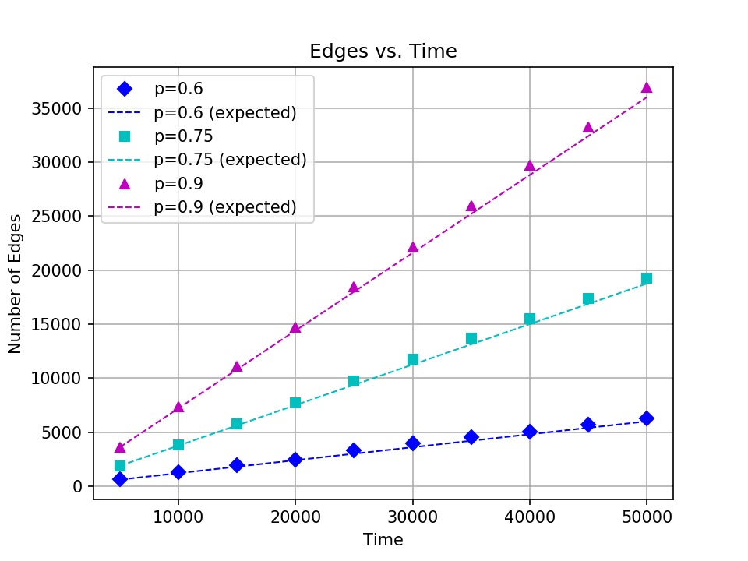
Distribution of Edges with change in Time
From the graph, it can be noticed that as time ‘t’ increases, the number of edges (m_{t}) in the graph G_{t} increases linearly.
The analytical formula to find the find the expected number of nodes with change in t is given by: E(m_{t}) = p(p – q)t Where p is the probability of adding a node and q is the probability of deleting a node.

Slide 5
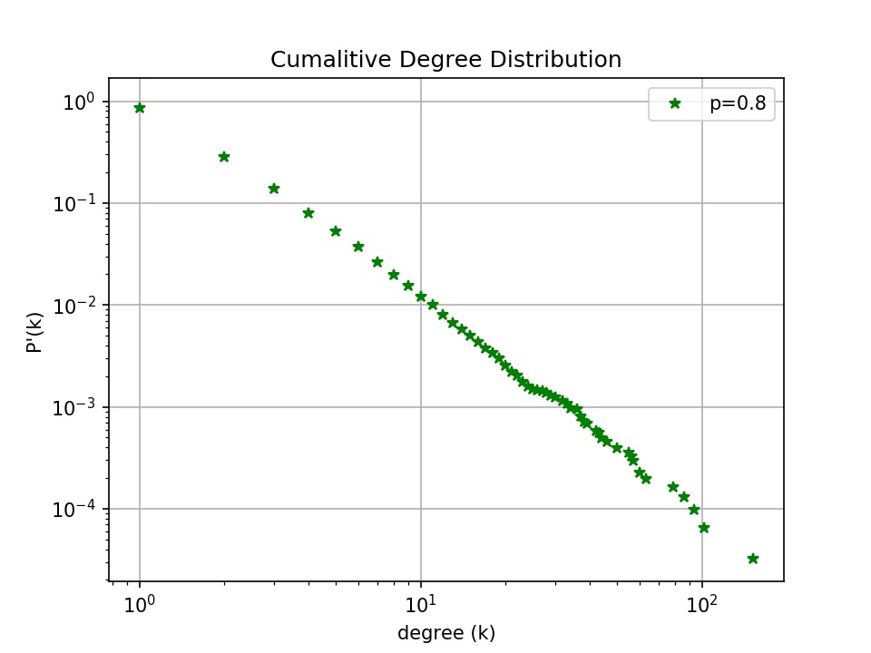
Degree Distribution:
The graph shows the cumulative probability distribution where a randomly chosen node to will have a degree ‘k’.
It can be noticed that, as degree ‘k’ increases, the probability of finding a node with that value of ‘k’ reduces.
In order to reduce the statistical noise in the tail of the distribution, P’(k) vs. k has been plotted instead of P(k) vs. k.
Where P’(k) = ∑_{i ≥ k} P(i)

